Slide 1
DESIGN AND IMPLEMENTATION OF INTERNET OF THINGS BASED SMART ENERGY MONITORING AND CONTROLLING SYSTEM
Supervised By
Saiful Islam
Lecturer
Department of Computer Science and Engineering
International Islamic University Chittagong.
Presented By
S M Hisbullah Hasnat (C163014)
Md. Jahidul Alam (C163015)
Md. Mustafa Arkan (C163032)

Slide 2
Presentation Outline
Background
Problem Statement
Literature Review
Objective
Methodology
System Implementation
Result Analysis
Discussion
Summary of the Findings
Contribution
Limitation
Limitation and Future Work

Slide 3
Background
Energy consumption measurement is a major yardstick of a nation’s progress today.
Early energy meter has mechanical design to measure the parameters.
These meters has no user interaction.

Slide 4
Problem Statement
According to the research by Power Cell BD, there are 11.23% power loss in Bangladesh everyday [1].
Due to increasing demand of electricity, power utilities and governments are facing a number of problems like power shortage.
Without a proper management of power usage, it is nearly impossible to reduce power shortage, maintain proper billing etc.

Slide 5
Literature Review
Title | Techniques | Limitations
Arduino Based Energy monitoring System using GSM [2] | Used Arduino Uno module for measuring the parameters. | No IoT panel was introduced in this system.
Design and Implementation of an IoT based Energy Metering [3] | Author has used various sensors and designed a basic IoT panel for monitoring device status. | The IoT panel is only available in local host, can’t be accessed from outside.
Smart Load Surveillance System using IoT [4] | User has used an interactive IoT panel for load controlling system. | In this system, no energy monitoring devices were equipped.

Slide 6
Objectives
To design a circuit for measuring voltage, current.
To show the result in LCD Display & send the result in consumers mobile.
To design an IoT panel for data reading and control from internet.

Slide 7
Methodology
Block Diagram
Circuit Diagram
Flow Chart

Slide 8
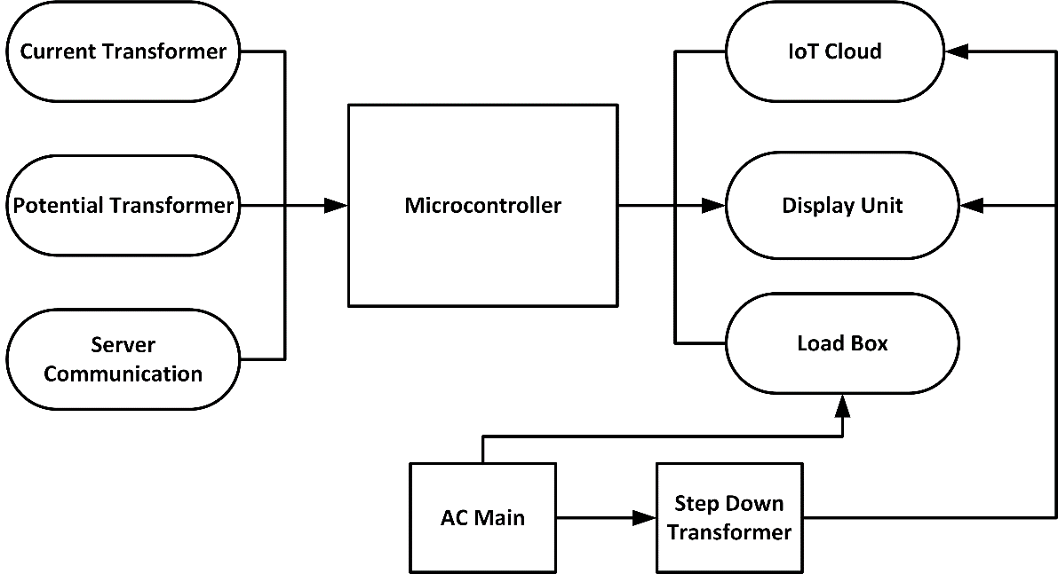
Methodology (Block diagram)
Fig 1 Overall Block Diagram

Slide 9
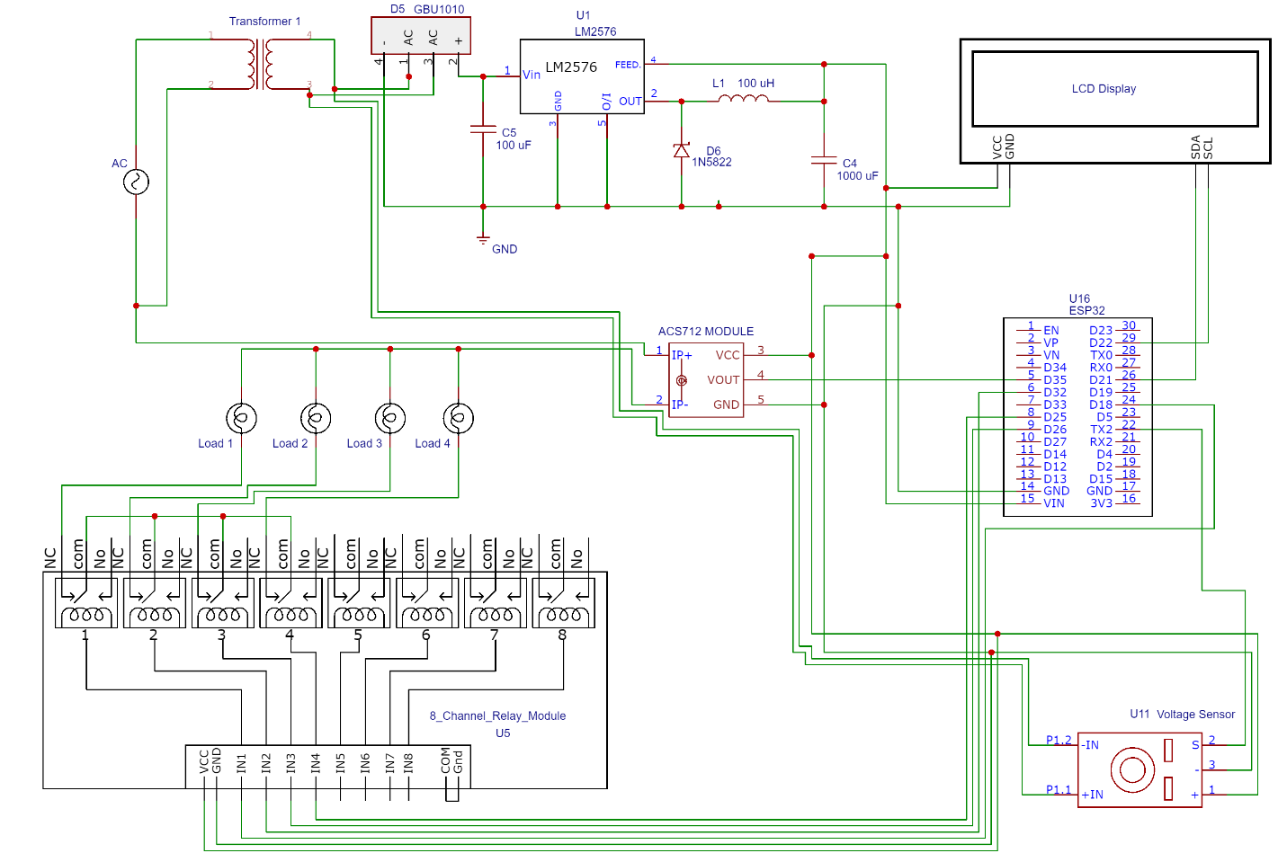
Methodology (Circuit Diagram)
Fig 2 Circuit Diagram

Slide 10
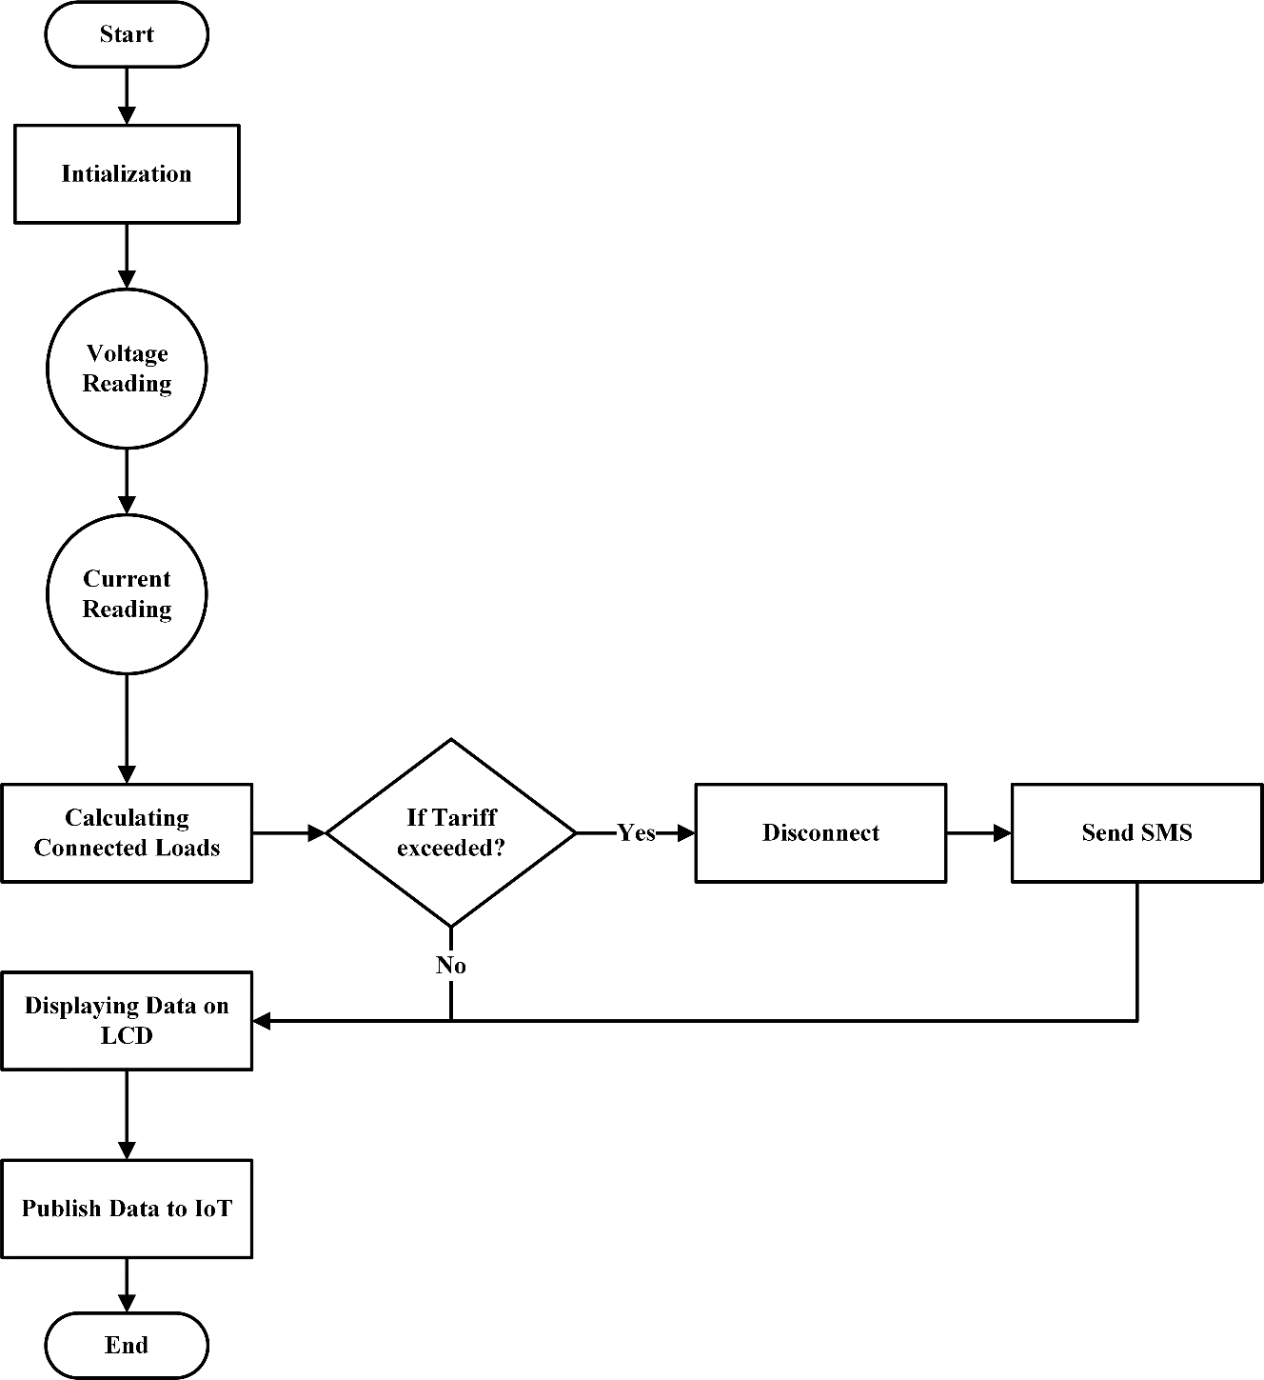
Methodology (Flow Chart)
Initializing components
Checking Sensors
Comparing sensor readings
End
Fig 3 Overall Flow Chart

Slide 11
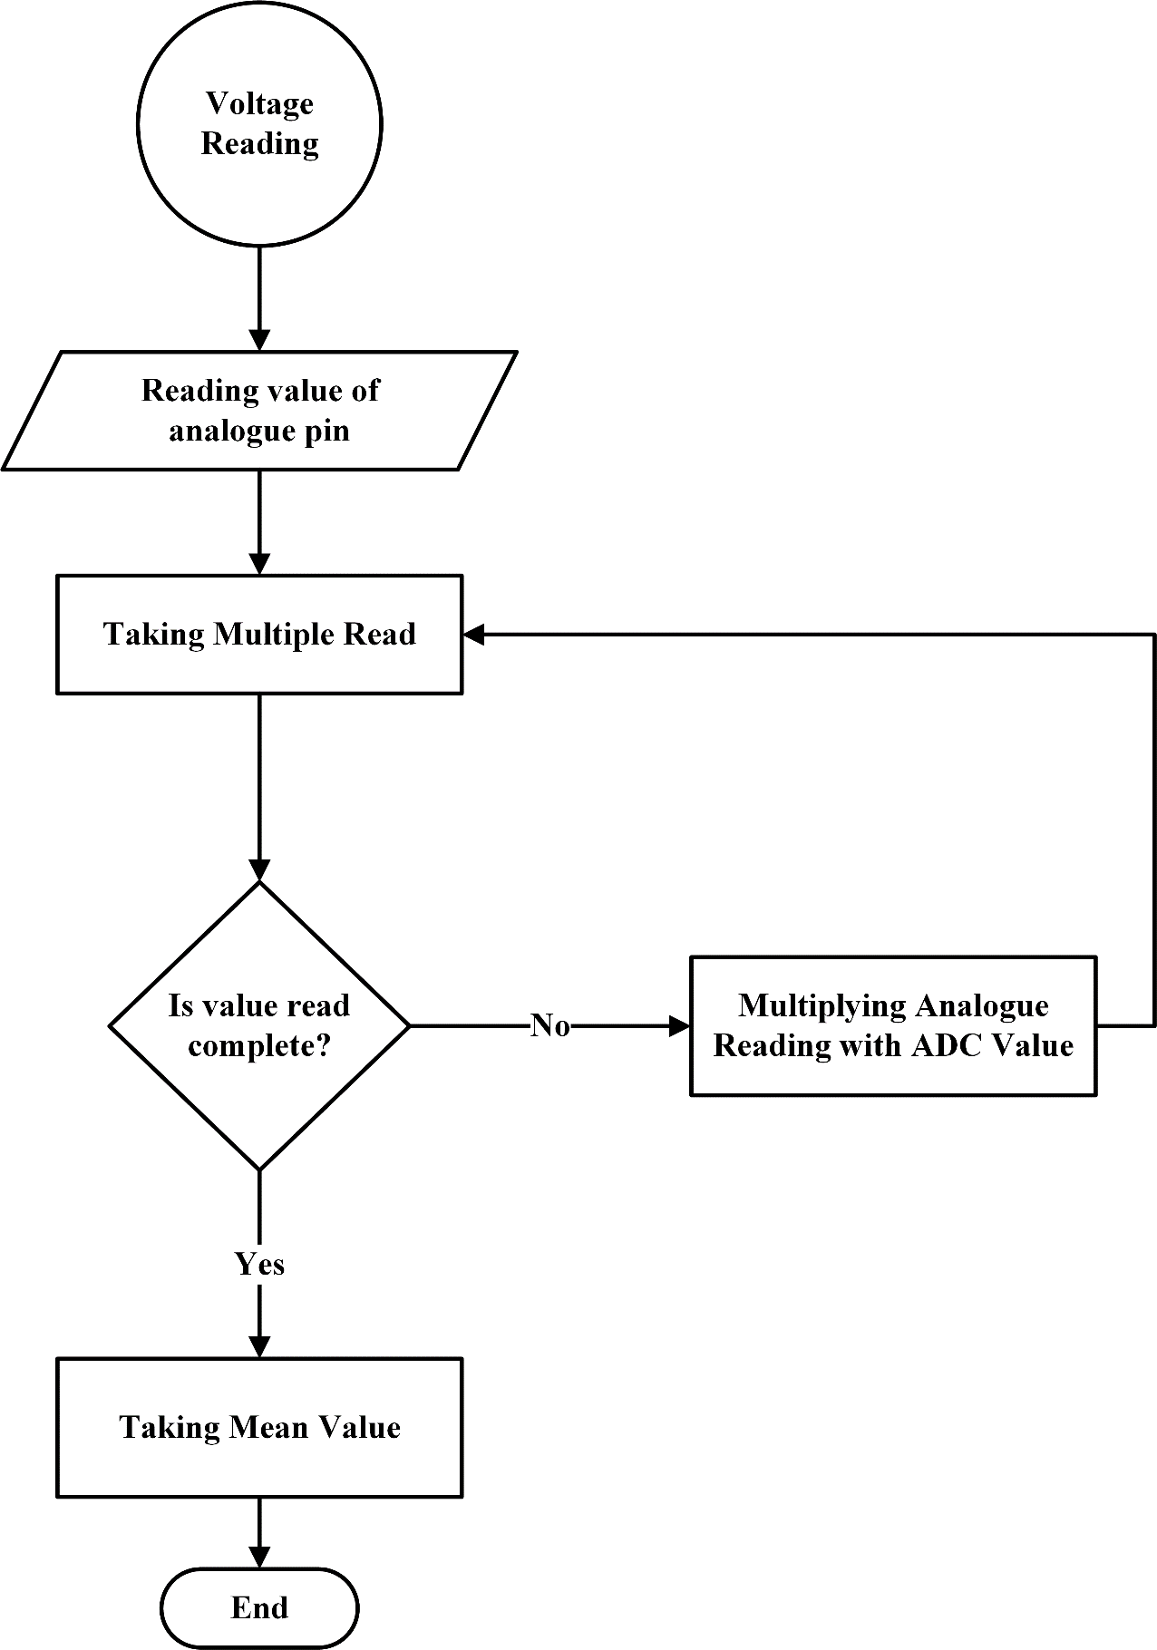
Methodology (Flow Chart)
Reading voltage sensor
Reading analog value
Taking mean value
End
Fig 4 Read Voltage Sensor

Slide 12
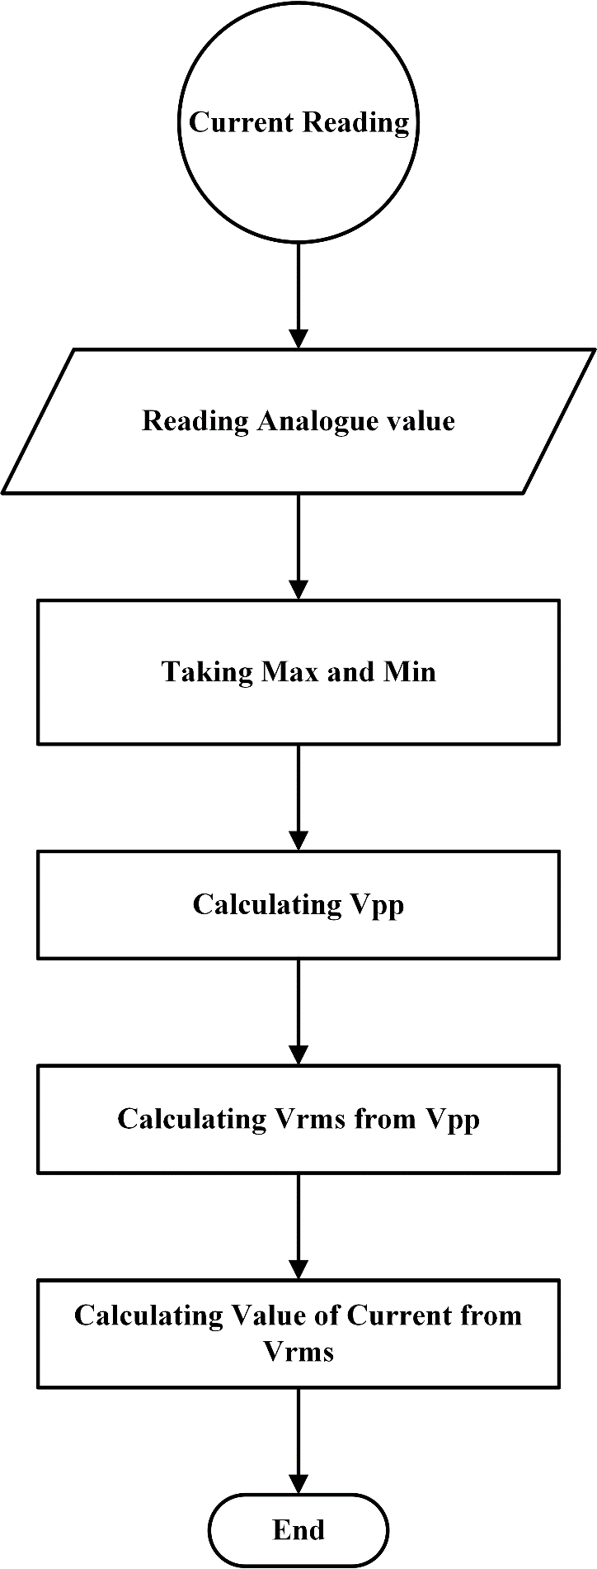
Methodology (Flow Chart)
Reading Analog Value
Taxing Max and Min
Calculating Vpp
Recording data
End
Fig 5 Read Current Sensor

Slide 13
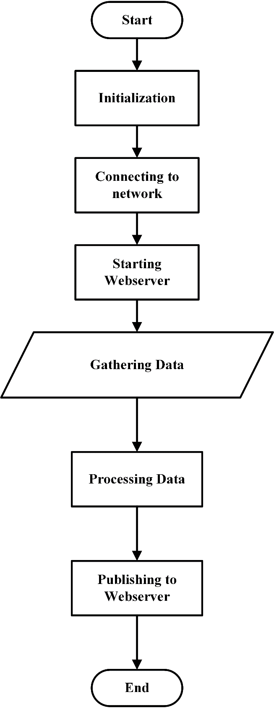
Methodology (Flow Chart)
Connecting to network
Starting Server
Processing Data
End
Fig 6 IoT Data

Slide 14
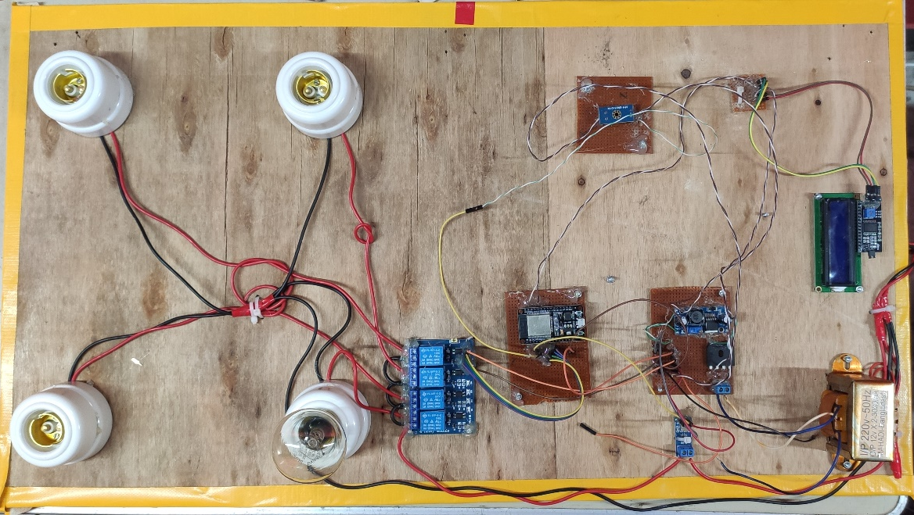
System Implementation
Fig 7 Hardware Implementation

Slide 15
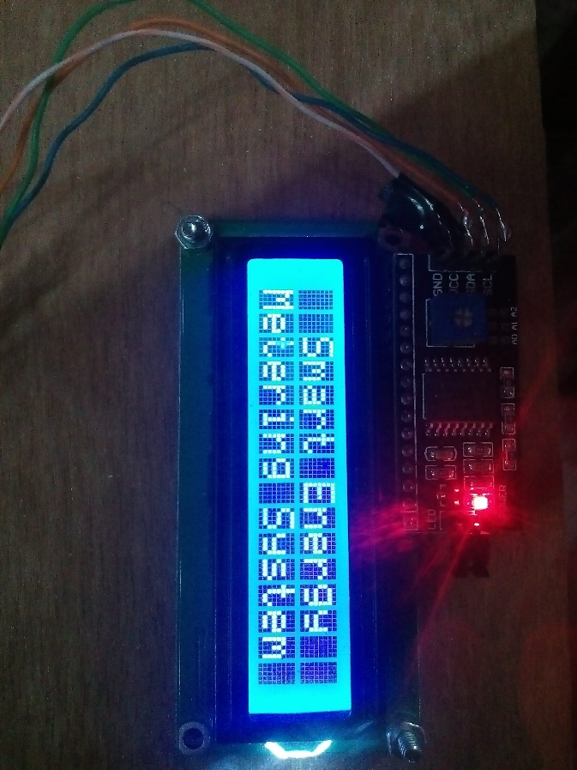
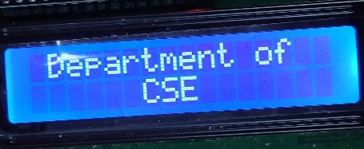
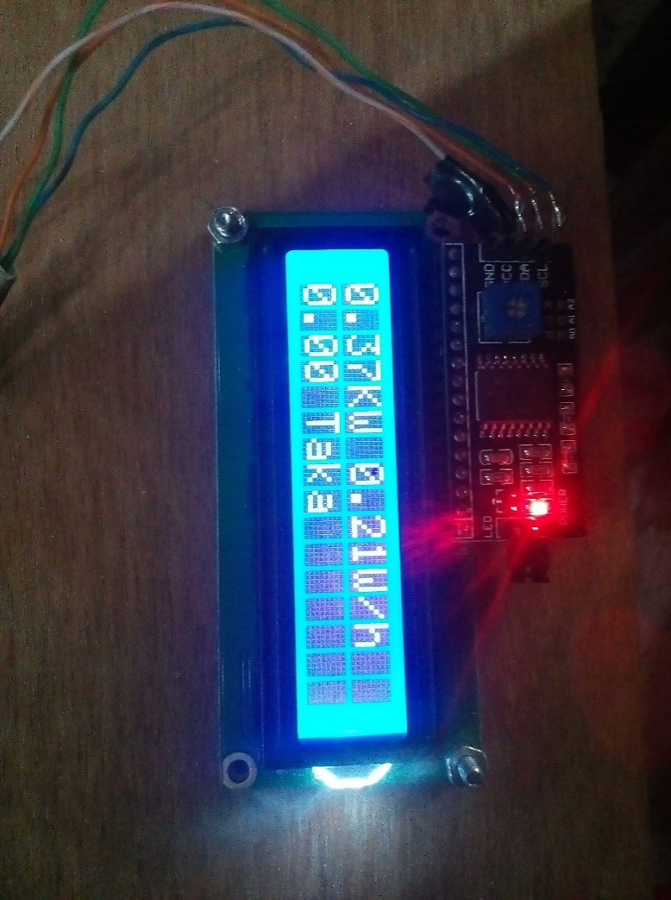
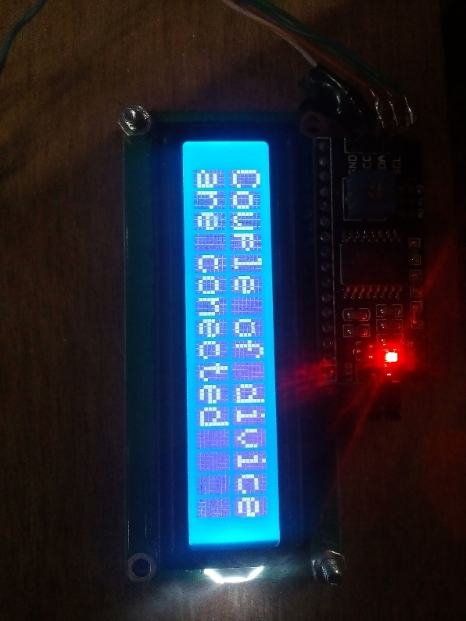
Result Analysis
Fig 8 Showing LCD Messages

Slide 16
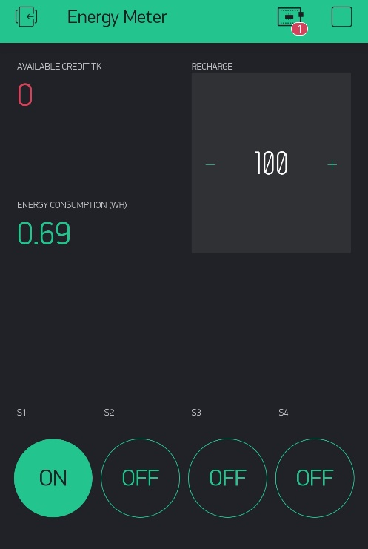
Result Analysis (Contd.)
Fig 9 IoT Panel

Slide 17
Result Analysis (Contd.)
Obs. | Voltage (V) |  | Current (A) |  | Power (Watt)
 | Practical | Measured | Practical | Measured | Practical | Measured
1 | 204 | 218 | 0.37 | 0.35 | 200 | 204
2 | 209 | 217 | 0.64 | 0.66 | 400 | 410
3 | 203 | 213 | 0.74 | 0.74 | 600 | 615
4 | 214 | 215 | 1.00 | 1.01 | 800 | 821
5 | 212 | 215 | 1.34 | 1.34 | 1000 | 1034
6 | 202 | 219 | 1.60 | 1.65 | 1200 | 1241

Slide 18
Result Analysis (Contd.)
Balance Condition | Predication at Full Load (Approximately)
Less than 100 | 21 days
Less than 70 | 17 days
Less than 40 | 10 days
Less than 10 | 2 days

Slide 19
Discussion
This system can be used for measuring energy consumption of household and industries.
It can be used for measuring and tracking data real time from remote areas.

Slide 20
Summary of the Findings
Smart and Interactive system.
User can monitor data from anywhere using the mobile app.
User can switch the devices remotely and monitor the data according to it.

Slide 21
Contribution
The implementation of IoT is an important contribution of this system.
User can check load and balance in real time from the remote panel.
The loads can be controlled and monitored remote which is a significantly improvement from the previous works.

Slide 22
Limitations
• The system is not packed in a single box enclosure system.
• The components are not mounted in a single PCB layout.
• Some electronic components fails sometimes due to heavy noise while load change occurs.

Slide 23
Future Improvement
It will use a central cell number to collect the messages sent from the consumers Smart Wattmeter.
It automatically analysis the data and calculate them to gain necessary information that is required by generation station and for the distribution system.

Slide 24
References
[1] “System-Loss” http://www.powercell.gov.bd/site/page/d25a46c5-6c0f-47d7-94f2-9ac4351f4404/System-Loss (accessed Feb. 17, 2021).
[2] V. Preethi and G. Harish, “Design and implementation of smart energy meter,” in 2018 International Conference on Inventive Computation Technologies (ICICT), 2018, pp. 1–5.
[3] N.T. Makanjuola, O. Shoewu, L.A. Akinyemi and A.A. Ajasa, 2018. Design and Development of a Microcontroller Based Digital Wattmeter (MIDIWAT).
[4] R. G. Sarangle, U. Pandit, K. Prof, and J. Modi, “Smart load Surveillance Using IoT,” vol. 1, no. 4, pp. 273–279, 2019.

Slide 25
Thank You

